Slide 1

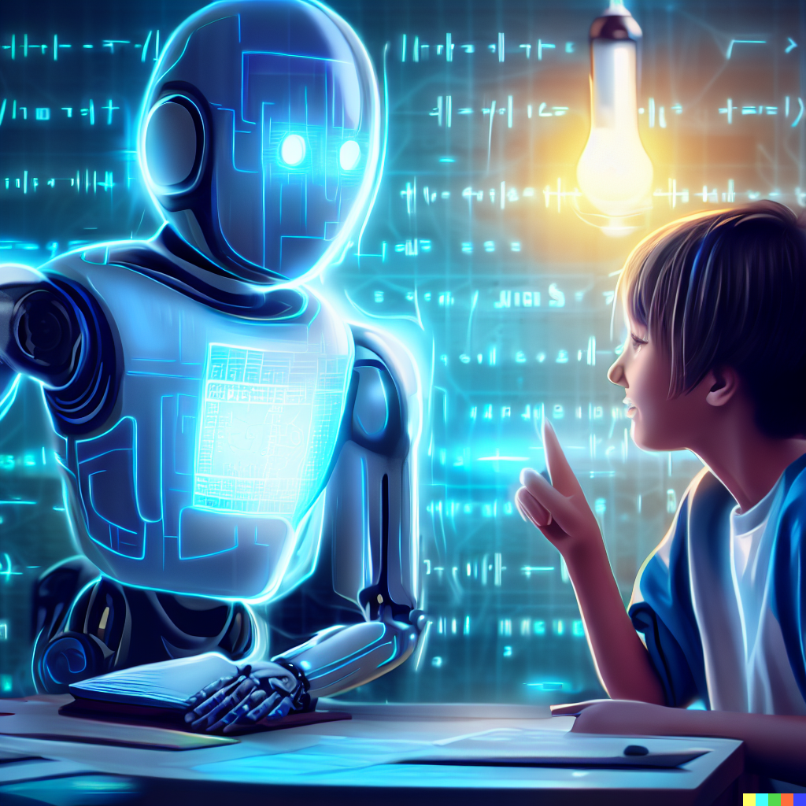
Are LLM-based Chatbots Reliable and Safe Enough to Provide Free Data Science Tutoring for Marginalized Communities?
DATASCI 207 Summer 2023
Shin, Fong, Lister, Hodges
Notes:
Title, Authors
What is the question you will be working on? Why is it interesting?
What is the data you will be using? Include data source, size of dataset, main features to be used. Please also include summary statistics of your data.
What prediction algorithms do you plan to use? Please describe them in detail.
How will you evaluate your results? Please describe your chosen performance metrices and/or statistical tests in detail.

Slide 2
Tutoring Marginalized Communities in Data Science
Address social disparities: provide equal access to technical knowledge
Create economic opportunities: equip students with high demand skills
Foster innovation and problem-solving: encourage diverse contributions to the field
Promote empowerment and inclusion: empower students with knowledge and skills to actively participate in data science
Stimulate community empowerment and development: enable students to take active role in solving local community challenges
Notes:
We were motivated to explore the topic of tutoring marginalized communities in data science in hopes that we could help

Slide 3
LLMs Background / Overview
LLMs - a seismic shift
Multiple layers of neural networks
Generating text one token at a time, predicting the next based on current sequence
Companies are producing both closed- and open-source models:
ChatGPT, LLaMA, Falcon, Pythia, StableLM, and more
LLaMA 2
Notes:
As we have explored in class, large language models have achieved impressive results in a wide range of natural language processing tasks such as text summarization, machine translation, text generation, question answering, and more.
LLMs are comprised of multiple layers of neural networks, and can generate natural language based on a given input, such a prompt, a question, or a context.
They are trained on massive amounts of data from diverse sources so that they can capture statistical patterns and semantic relationships of natural language.
They generate text one token at a time, predicting the next token based on the current sequence of tokens
Currently, companies are producing both closed and open source models:
ChatGPT: which can generate coherent and engaging conversational responses, based on the GPT-2 architecture and fine-tuned on a large-scale dialogue dataset.
LLaMA and LLaMA 2: which can answer complex factual and commonsense questions, based on the BERT and T5 architectures and trained on a combination of knowledge bases and natural language corpora.
Falcon: which can generate factual and fluent summaries of long documents, based on the BART architecture and trained on a new dataset of document-summary pairs.
Pythia: which can generate natural language explanations for machine learning predictions, based on the GPT-3 architecture and fine-tuned on a dataset of prediction-explanation pairs.
StableLM: which can generate stable and consistent outputs across different runs, based on the GPT-2 architecture and enhanced with a stability loss function and a stability evaluation metric.

Slide 4
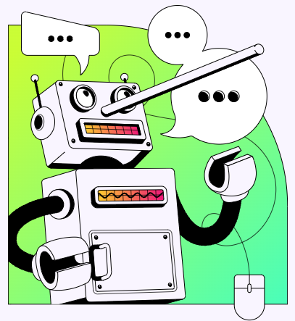
Hallucinations
"Hallucinations are a model's logical mistakes or a tendency to invent facts in moments of uncertainty" - OpenAI, May 2023
Notes:
Large language model used for natural language generation generates text that is “nonsensical” or “unfaithful” based on the input.
Hallucinations can have many risks
Medical setting
The term “hallucination” can mean different things depending on the task you are trying to achieve
For example, the term first came from the computer vision field and denoted concepts such as image synthesis
Seen as something to take advantage of rather than avoid
In natural language generation contexts, the term hallucination is more closely related to the psychological term, in that hallucinated text can seem fluent and natural despite being “unfaithful” and “nonsensical”
It can be hard to catch at first glance
Since in our task we are looking to give in-depth explanations for the sake of explaining data science concepts, we can define hallucinations for our task similar to that of any generative question answering task. More specifically, hallucination can be measured by the factual correctness of a generated answer.
Recent work uses the term semantic drift to describe how an answer drifts from a correct one during generation

Slide 5
Mitigating Hallucinations
Neural Generative Question Answering (GENQA)
Knowledge-Enriched Answer Generator (KEAG)
Fine tuning
Notes:
Early works tried to improve the faithfulness of an answer through exploration of reliable external knowledge sources or pulling in multiple information sources
One approach is called Neural Generative Question Answering, which is an end-to-end model that answers simple factoid questions based on the knowledge base
Another approach is called Knowledge-Enriched Answer Generator, wherein a natural answer is generated using facts from four different information sources: questions, passages, vocabulary, and knowledge
One clear limitation of these approaches is that they require high-quality, relevant resources that would closely match any potential questions to be answered
These are not always easily available
Another approach would be to re-train layers of a large language model using domain-specific knowledge, on the next slide Edward will discuss why we did not take this approach

Slide 6
Retrieval-Augmented Generation (RAG) and Prompt Engineering vs Fine-Tuning
RAG can better minimize hallucinations and other undesirable responses in conversational applications
RAG sees new content made available in near real-time
Fine-tuning takes multiple hours
RAG can enrich LLM’s limited context window from unlimited semantically relevant content for the use case at hand
GPT 3.5 has 4k token limit
Notes:
Edward
Title, Authors
What is the question you will be working on? Why is it interesting?
What is the data you will be using? Include data source, size of dataset, main features to be used. Please also include summary statistics of your data.
What prediction algorithms do you plan to use? Please describe them in detail.
How will you evaluate your results? Please describe your chosen performance metrices and/or statistical tests in detail.

Slide 7
Retrieval-Augmented Generation (RAG) and Prompt Engineering vs Fine-Tuning
RAG and prompt engineering are orders of magnitude cheaper than fine-tuning LLM layers
Retrieval index can be ‘hot-swapped’ to update a RAG model
With RAG, we can gain insight into predictions since accessed knowledge can be inspected and interpreted
Restricted content can be filtered at runtime
Protect proprietary, enterprise data
Notes:
Edward
Title, Authors
What is the question you will be working on? Why is it interesting?
What is the data you will be using? Include data source, size of dataset, main features to be used. Please also include summary statistics of your data.
What prediction algorithms do you plan to use? Please describe them in detail.
How will you evaluate your results? Please describe your chosen performance metrices and/or statistical tests in detail.

Slide 8
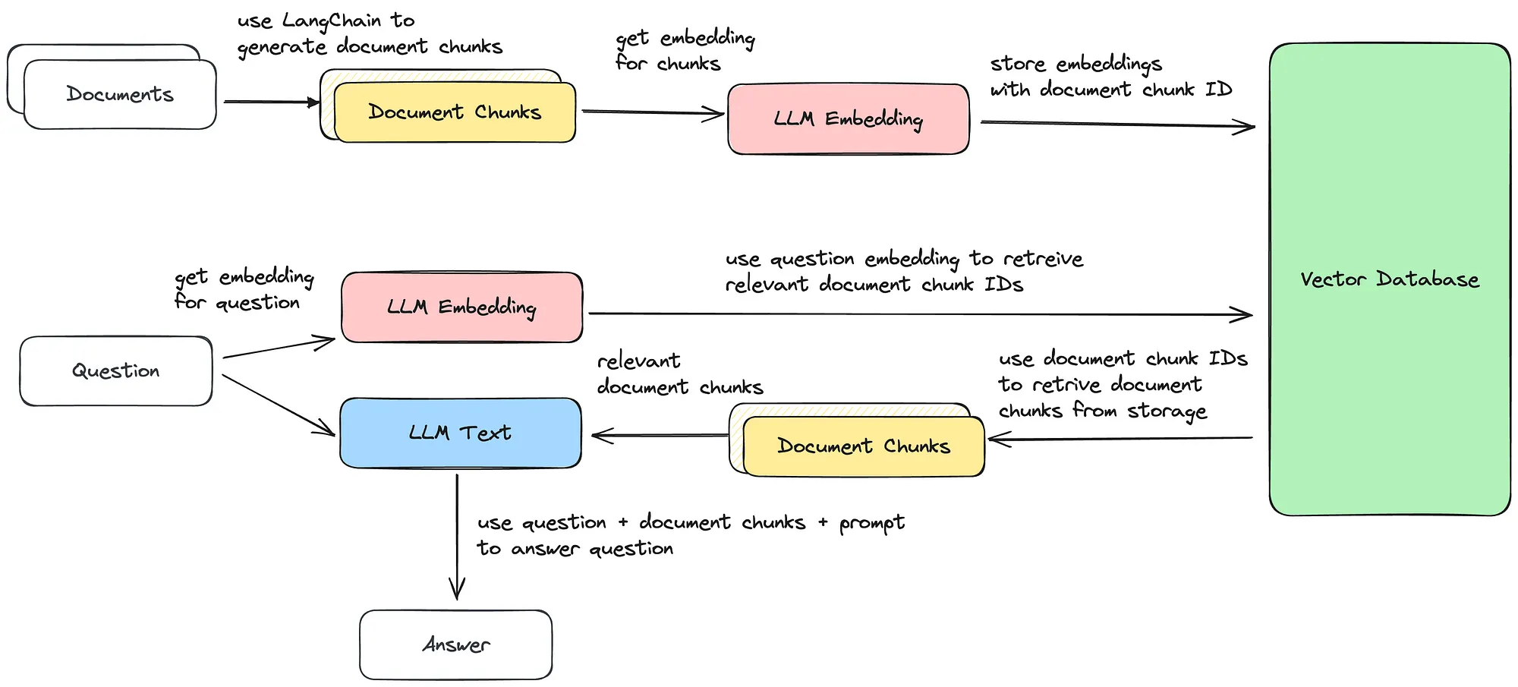
Retrieval-Augmented Generation (RAG) Flow
Notes:
Title, Authors Edward
What is the question you will be working on? Why is it interesting?
What is the data you will be using? Include data source, size of dataset, main features to be used. Please also include summary statistics of your data.
What prediction algorithms do you plan to use? Please describe them in detail.
How will you evaluate your results? Please describe your chosen performance metrices and/or statistical tests in detail.

Slide 9





Instruction-Tuned LLMs to Evaluate
Llama 2
TII Falcon
Vicuna
Notes:
Neil
Title, Authors
What is the question you will be working on? Why is it interesting?
What is the data you will be using? Include data source, size of dataset, main features to be used. Please also include summary statistics of your data.
What prediction algorithms do you plan to use? Please describe them in detail.
How will you evaluate your results? Please describe your chosen performance metrices and/or statistical tests in detail.
The two LLMs that we eventually settled on evaluating were ChatGPT 3.5 and Llama 2. ChatGPT was an obvious choice as its probably the most well recognized LLM on the market today, but we also wanted to review the results of more than just one model. We decided to go with Llama 2 from Meta which isn’t nearly as well known but is still one of the top performing LLMs available.

Slide 10
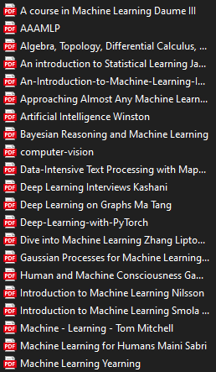
Data Science Textbooks Dataset
47 publicly available textbook PDFs
Ranging 1.8 MB to 87.9 MB in size
Machine learning, statistics, data science
Notes:
Title, Authors
What is the question you will be working on? Why is it interesting?
What is the data you will be using? Include data source, size of dataset, main features to be used. Please also include summary statistics of your data.
What prediction algorithms do you plan to use? Please describe them in detail.
How will you evaluate your results? Please describe your chosen performance metrices and/or statistical tests in detail.
Why textbooks? (vs journals, blogs) https://arxiv.org/abs/2306.11644
An important distinction to make here is that unlike traditional ML like we’ve been talking about in class, our approach was to leverage pre-trained models. As Edward mentioned earlier, RAG is a methodology to enhance an existing model by pulling from more detailed and specific sources during the process of generating an output. In our case we sourced almost 50 publicly available textbooks to serve as these sources, and these were all focused on ML or statistics for topics.

Slide 11
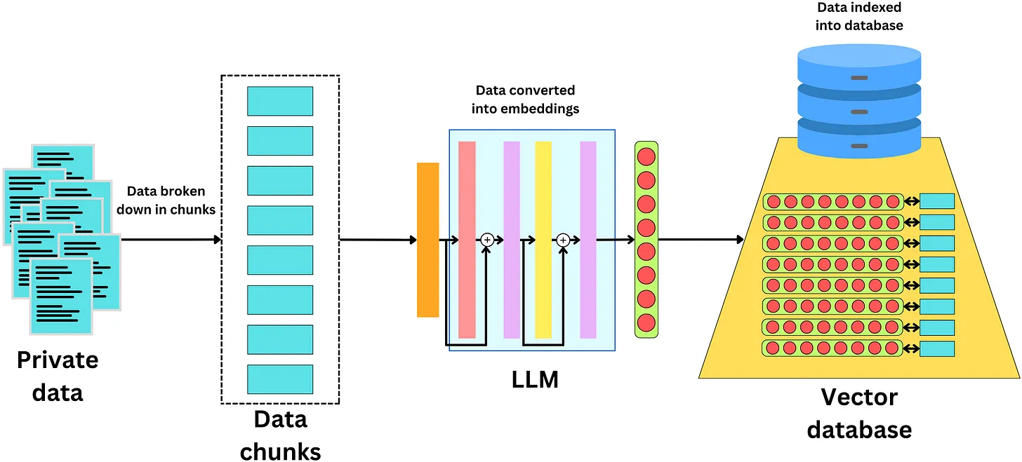
Indexing Textbooks as Embeddings with Langchain
Notes:
Title, Authors Neil
What is the question you will be working on? Why is it interesting?
What is the data you will be using? Include data source, size of dataset, main features to be used. Please also include summary statistics of your data.
What prediction algorithms do you plan to use? Please describe them in detail.
How will you evaluate your results? Please describe your chosen performance metrices and/or statistical tests in detail.
An important part of getting these textbooks into a readable state for the LLMs is to break them down into more manageable bite sized pieces. The breakdown of the text into smaller sections both simplifies the analysis process for LLMs and also helps facilitate relevant responses. All of this serves to enhance the model’s efficiency and preserve the original meaning of the information that is fed into them. Like we talked about in the small bit about NLP in our class, these chunks get converted into embeddings and are stored in a vector database for later retrieval and use.

Slide 12
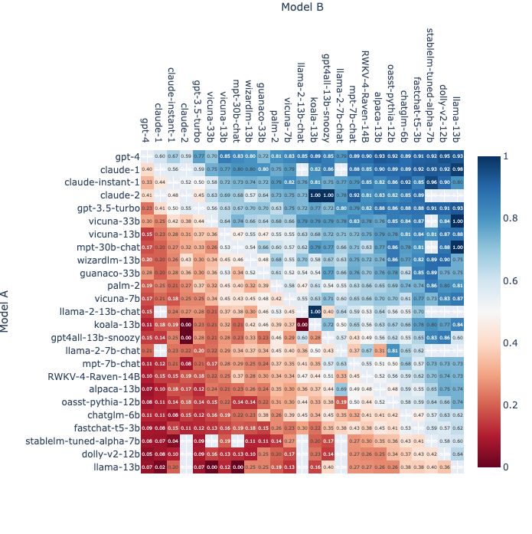
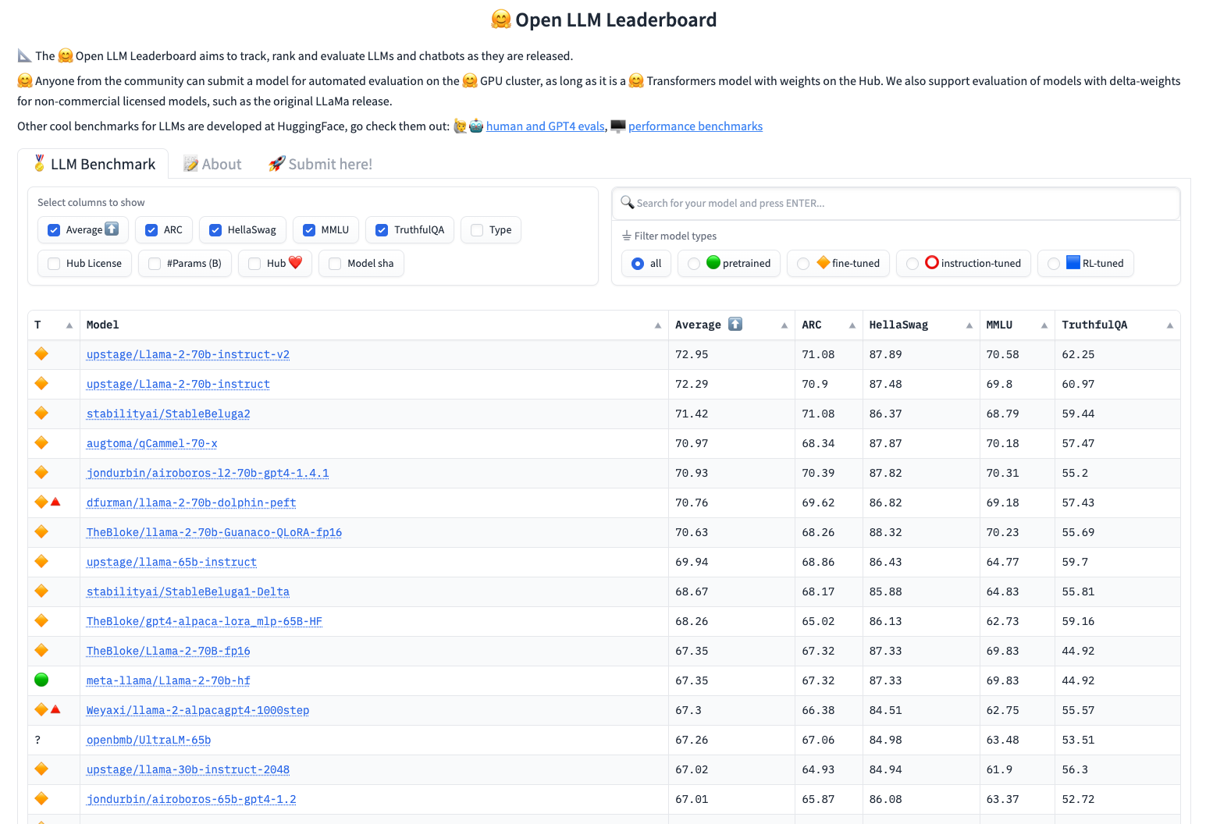
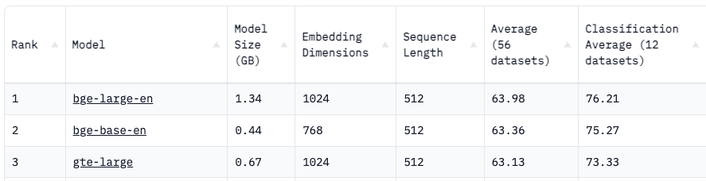
LLM Evaluation Techniques

Slide 13

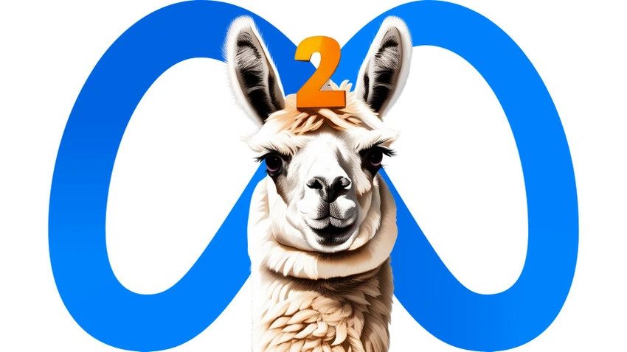
GPT-4
Evaluation
Human
Instruction:
Explain the meaning of the given phrase in simple terms. Use an example if possible. It would be helpful if you could give an example.
Input:
"With a little give in them"
Response 1:
With a little bit of flexibility, they can
bend and adapt to different situations.
Response 2:
The phrase "with a little give in them"
means to have a bit of flexibility or room for compromise.
Evaluation:
Response 2 is better because it provides a clear and concise explanation of the meaning of the phrase.
Reference Response:
The phrase "with a little give in them" means to have a bit of flexibility or room for compromise.
GPT-4
Llama 2

Slide 14
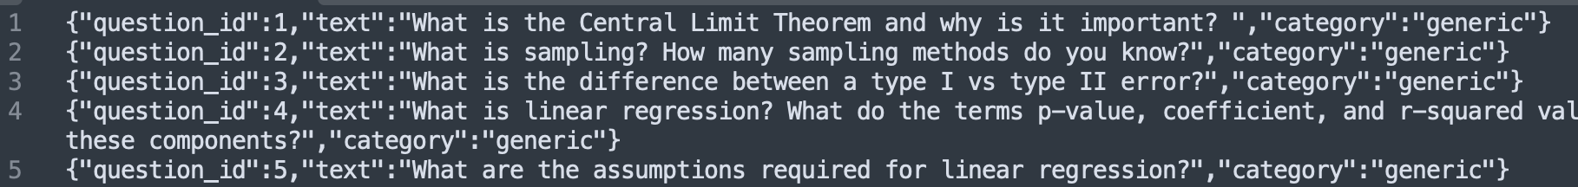
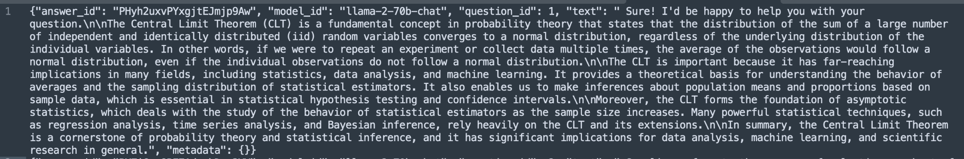

Evaluation Questions

Slide 15
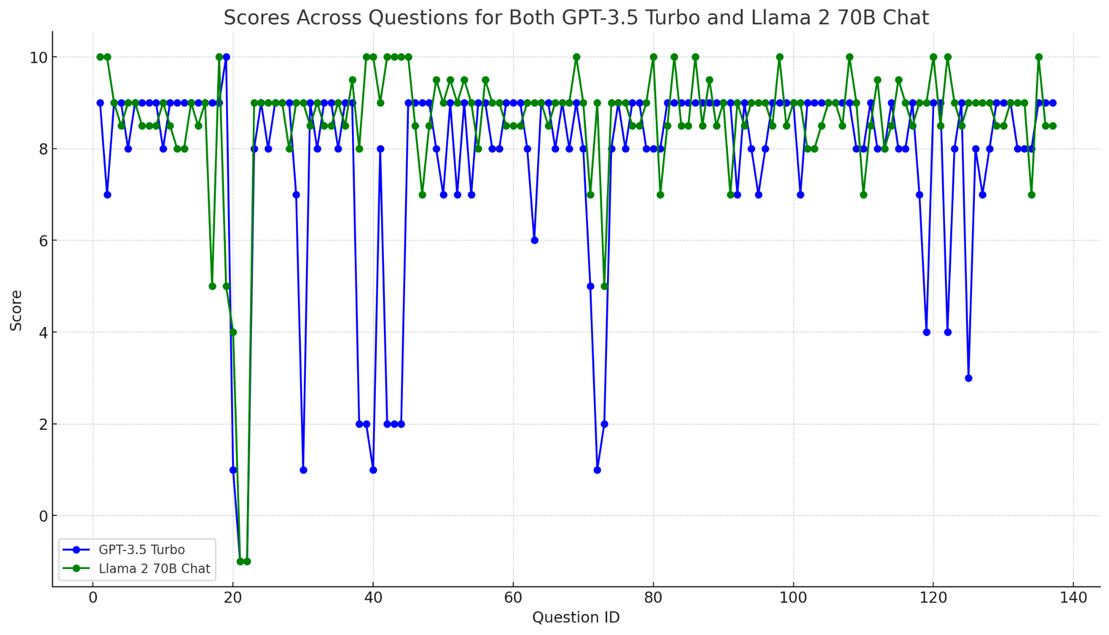
Evaluation Results
137 Data Science Questions
Topics covered include statistics, machine learning, math, python and related topics
Answers evaluated by GPT-4 and scored 1-10

Slide 16
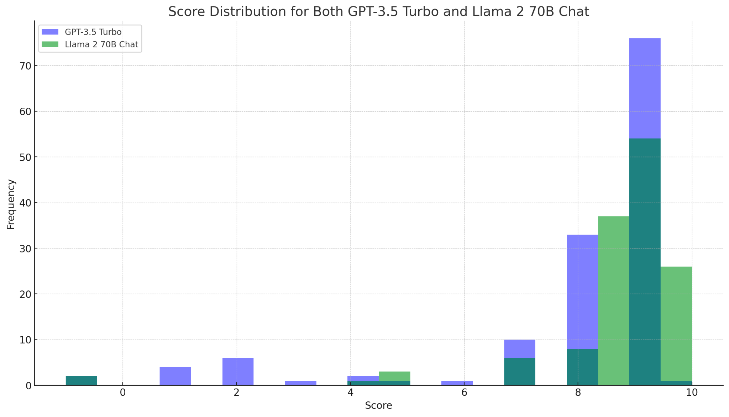
Evaluation Results
Assistant 1 (GPT-3.5 Turbo):
Total Score - 1064.0
Average Score Per Question - 7.766423357664234
Assistant 2 (Llama 2 70B Chat):
Total Score - 1179.5
Average Score Per Question - 8.609489051094891

Slide 17
Evaluation Limitations
LLM responses and output are non-deterministic e.g. the same prompt executed twice gives two different answers
The 137 questions test set is relatively small and doesn’t cover all aspects of data science
Due to time and cost constraints, we weren’t able to leverage more questions, add human or mechanical turk evaluations, or focus more on content retrieval similarity/distance testing as originally intended
Overall, we believe LLMs can be leveraged for a data science tutor chatbot. However, not on its own and will require substantial guardrails and validation of the inputs from human users and outputs from the LLM to maintain the required safety and compliance.

Slide 18
Questions?

Slide 19
Contributions
Edward Shin
Sourced ML textbook “dataset”
Worked on model selection, RAG and testing
Presentation editing and covered RAG theory/applications.
Neil Fong
Covered LLM selection and data sourcing/formatting sections of presentation
Sourced ML textbook “dataset”
Derived, organized, and cleaned evaluation questions
Sydney Lister
Background theory research on LLMs, hallucinations, RAG, fine-tuning
Cross-checked ML textbook “dataset” and evaluation question categorization
Presentation content development and editing
Jonathan Hodges
Managed evaluation section of presentation
Developed Python and Jupyter notebook code to evaluate the two LLMs with RAG and visualize the results
Prototype chatbot in Streamlit and demo video in slides folder

Slide 20
References
Judging LLM-as-a-judge with MT-Bench and Chatbot Arena by Lianmin Zheng, Wei-Lin Chiang, Ying Sheng, Siyuan Zhuang, Zhanghao Wu, Yonghao Zhuang, Zi Lin, Zhuohan Li, Dacheng Li, Eric. P Xing, Hao Zhang, Joseph E. Gonzalez, Ion Stoica, June 9, 2023
Retrieval-Augmented Generation for Knowledge-Intensive NLP Tasks by Patrick Lewis, Ethan Perez, Aleksandra Piktus, Fabio Petroni, Vladimir Karpukhin, Naman Goyal, Heinrich Küttler, Mike Lewis, Wen-tau Yih, Tim Rocktäschel, Sebastian Riedel, Douwe Kiela, May 22, 2020
Textbooks Are All You Need by Suriya Gunasekar, Yi Zhang, Jyoti Aneja, Caio César Teodoro Mendes, Allie Del Giorno, Sivakanth Gopi, Mojan Javaheripi, Piero Kauffmann, Gustavo de Rosa, Olli Saarikivi, Adil Salim, Shital Shah, Harkirat Singh Behl, Xin Wang, Sébastien Bubeck, Ronen Eldan, Adam Tauman Kalai, Yin Tat Lee, Yuanzhi Li, June 20, 2023
PandaLM: An Automatic Evaluation Benchmark for LLM Instruction Tuning Optimization by Yidong Wang, Zhuohao Yu, Zhengran Zeng, Linyi Yang, Cunxiang Wang, Hao Chen, Chaoya Jiang, Rui Xie, Jindong Wang, Xing Xie, Wei Ye, Shikun Zhang, Yue Zhang, June 8, 2023
Generative AI for Programming Education: Benchmarking ChatGPT, GPT-4, and Human Tutors by Tung Phung, Victor-Alexandru Pădurean, José Cambronero, Sumit Gulwani, Tobias Kohn, Rupak Majumdar, Adish Singla, Gustavo Soares, June 29, 2023
INSTRUCTEVAL: Towards Holistic Evaluation of Instruction-Tuned Large Language Models by Yew Ken Chia, Pengfei Hong, Lidong Bing, Soujanya Poria, June 15, 2023

Slide 21
References
Improving Retrieval-Augmented Large Language Models via Data Importance Learning by Xiaozhong Lyu, Stefan Grafberger, Samantha Biegel, Shaopeng Wei, Meng Cao, Sebastian Schelter, Ce Zhang, July 6, 2023
Harvard Business Review: How to Train Generative AI Using Your Company’s Data by Tom Davenport and Maryam Alavi, July 6, 2023
Phoenix: ML Observability in a Notebook by Arize AI
Open LLM Leaderboard by HuggingFace
Chatbot Arena Leaderboard Updates by UC Berkeley, UCSD, CMU, MBZUAI
Deep Dive: How to Build a Smart Chatbot in 10 mins with LangChain by Damien Benveniste, May 25, 2023
What is Grounded Generation? by Vectara
Survey of Hallucination in Natural Language Generation by Ziwei Ji, Nayeon Lee, Rita Frieske, Tiezheng Yu, Dan Su, Yan Xu, Etsuko Ishii, Ye Jin Bang, Andrea Madotto, and Pascale Fung.
Addressing Semantic Drift in Generative Question Answering with Auxiliary Extraction by Chenliang Li, Bin Bi, Ming Yan, Wei Wang, Songfang Huang.
Neural Generative Question Answering by Jun Yin, Xin Jiang, Zhengdong Lu, Lifeng Shang, Hang Li, Xiaoming Li.
Incorporating External Knowledge into Machine Reading for Generative Question Answering by Bin Bi, Chen Wu, Ming Yan, Wei Wang, Jiangnan Xia, Chenliang Li.

Slide 22
Appendix

Slide 23


Slide 24
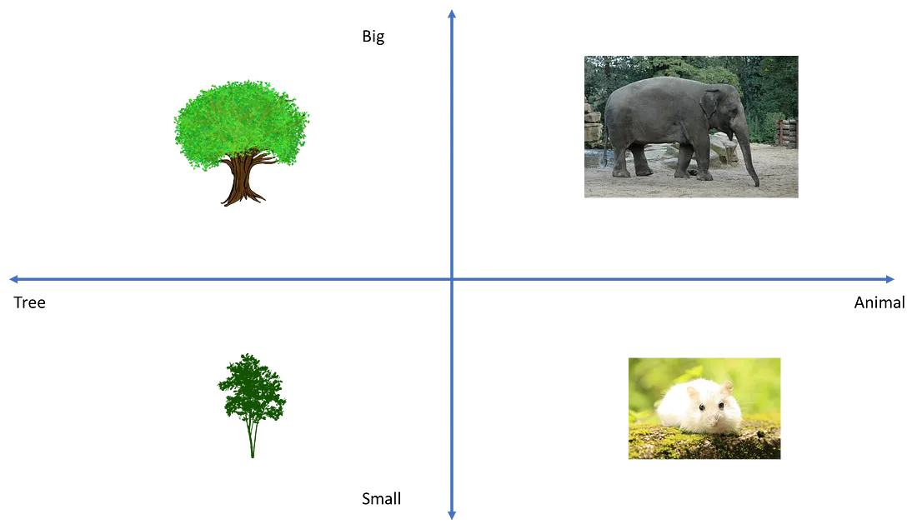

Slide 25
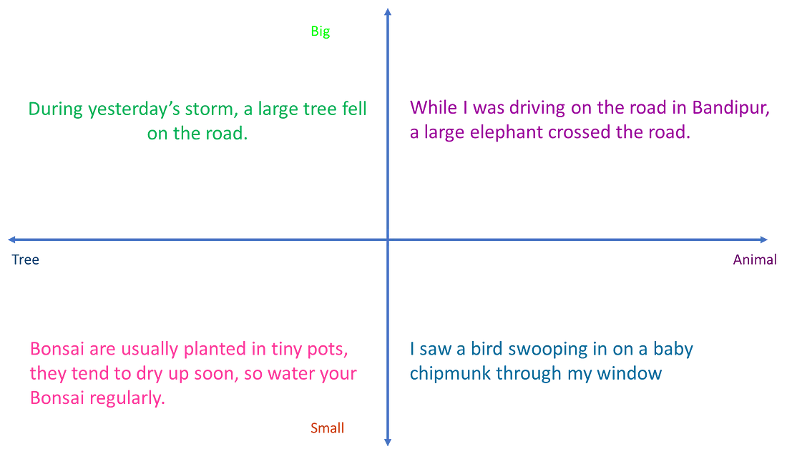

Slide 26
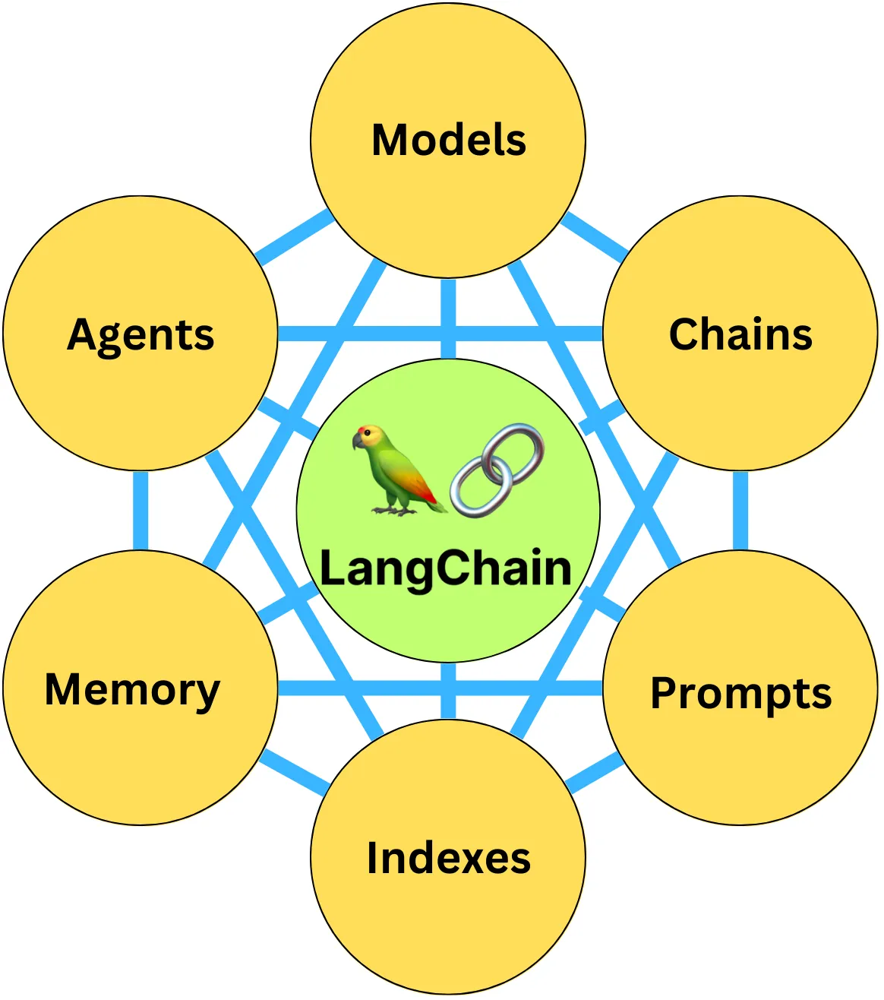
LangChain is a package to build applications using LLMs. It is composed of 6 modules

Slide 27
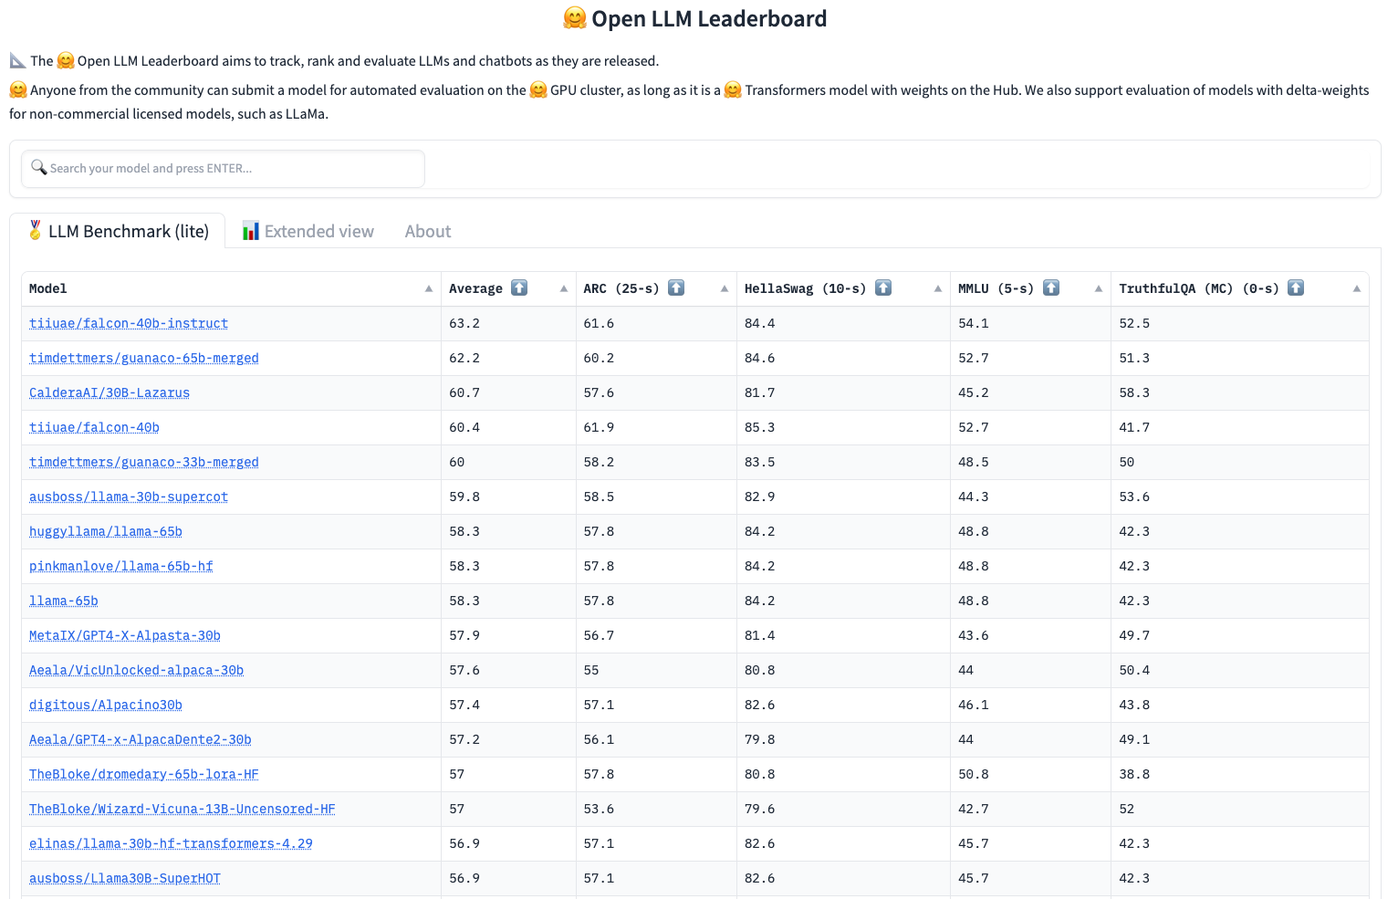

Slide 28
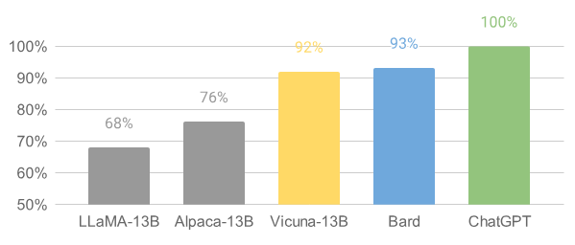
Our initial finding indicates that GPT-4 can produce highly consistent ranks and detailed assessment when comparing chatbots’ answers. Preliminary evaluations based on GPT-4, summarized in Figure 1, show that Vicuna achieves 90%* capability of Bard/ChatGPT. While this proposed framework shows a potential to automate chatbot assessment, it is not yet a rigorous approach. Building an evaluation system for chatbots remains an open question requiring further research.

Slide 29
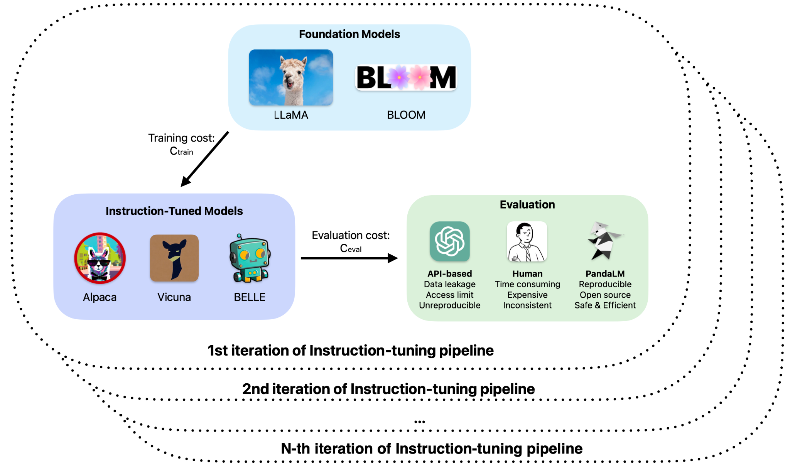

Slide 30
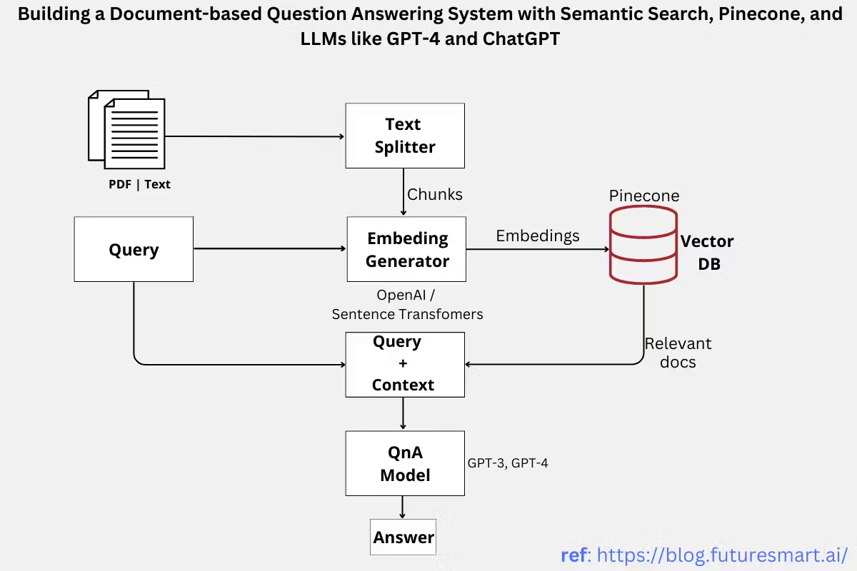

Slide 31
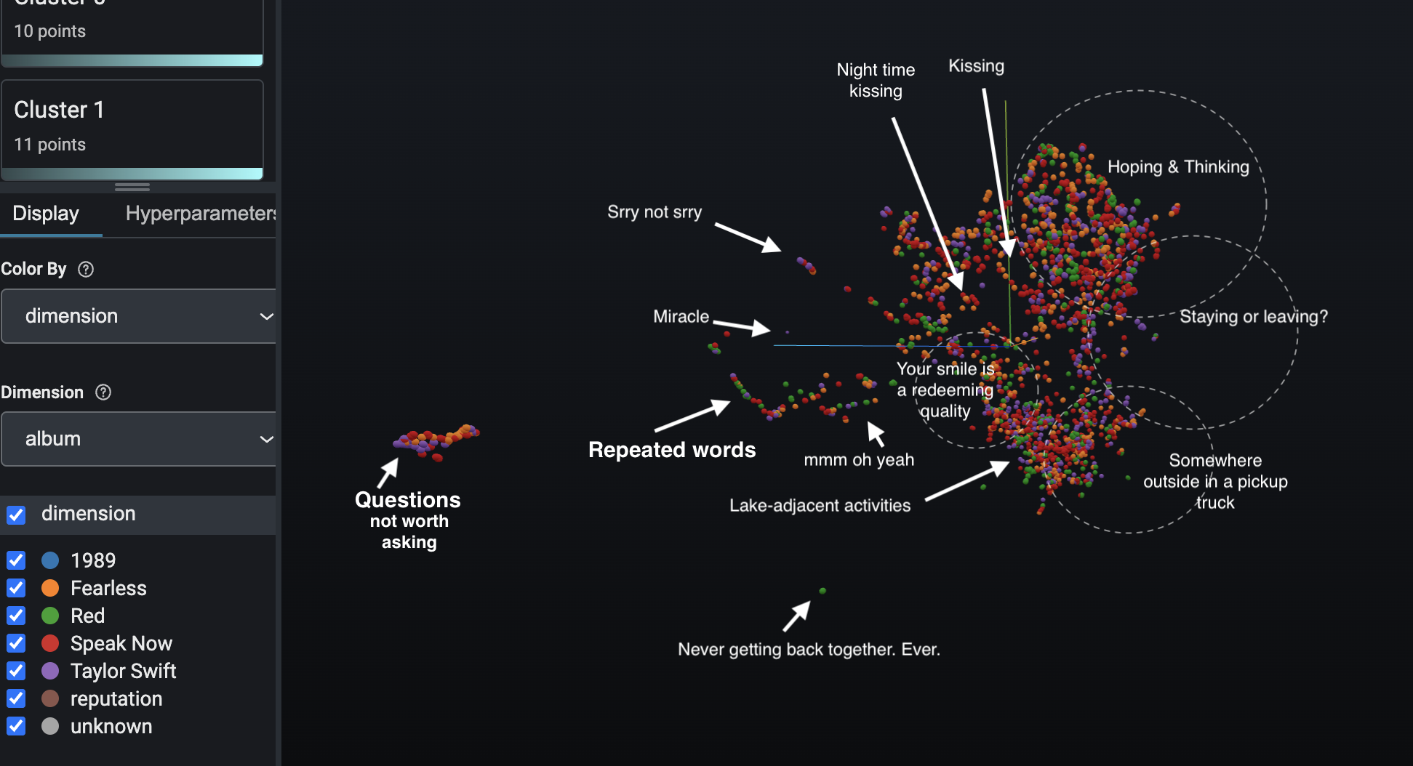
Phoenix to Analyze 4862 Rows of Taylor Swift Lyrics and Explore Trends
Image by Krystal Kirkland created using Arize Phoenix
Notes:
Title, Authors
What is the question you will be working on? Why is it interesting?
What is the data you will be using? Include data source, size of dataset, main features to be used. Please also include summary statistics of your data.
What prediction algorithms do you plan to use? Please describe them in detail.
How will you evaluate your results? Please describe your chosen performance metrices and/or statistical tests in detail.

